Slide 1
Library management system
Submitted by
Jana R
Griharan S
Hariprasanna S
HITHESH K

Slide 2
Abstract
LIBRARY MANAGEMENT SYSTEM is a project which aims in developing a computerized system to maintain all the daily work of library .A Library management system is a system that is used to maintain the records of the library. The record includes students and teachers who borrowed books from the library.
The library management system only can be used by the admin or Librarian who can add new member like student or teacher in the system along with their details. The admin can also update and delete members in the system. The library management system stores the detail of the member in the database.
The system also provide the book detail by just clicking on the name or title of the book which is already present in the book box.
When a student or teacher request a book to borrow, the detail of the book is add to the members detail.

Slide 3
Introduction
The “LIBRARY MANAGEMENT SYSTEM” is developed with the help of “PYTHON PROGRAMMING LANGUAGE” .The frontend of the software or system is developed with the help of “PYTHON TKINTER ”and the backend of the software is developed with the help of “MYSQL WORKBENCH 8.0”.
PYTHON TKINTER:
Tkinter is the defact way in Python to create Graphical User interfaces (GUIs) and is included in all standard Python Distributions. In fact, it's the only framework built into the Python standard library.
Out of all the GUI methods, Tkinter is the most commonly used method. It is a standard Python interface to the Tk GUI toolkit shipped with Python. Python with Tkinter is the fastest and easiest way to create the GUI applications. Creating a GUI using tkinter is an easy task.

Slide 4
Existing system
The Library Management System, librarian maintains the details of each book on the registers.
To find out the number of books available in the library they need to go check the entire entry which makes the process slow.

Slide 5
Problem statement
The main problem of existing system is you have to type the data of the book and members manually and it takes too much time and you have to calculate the number of days
So that it takes too much time manually typing the data for large database

Slide 6
PROPOSED SYSTEM
In our Library Management System you just need to click on the Book title which is already present in the book list and the data will automatically appears in the entry box
The system is also calculated the Number of Days to borrow the books and it also show the data of the member by clicking on the members name

Slide 7
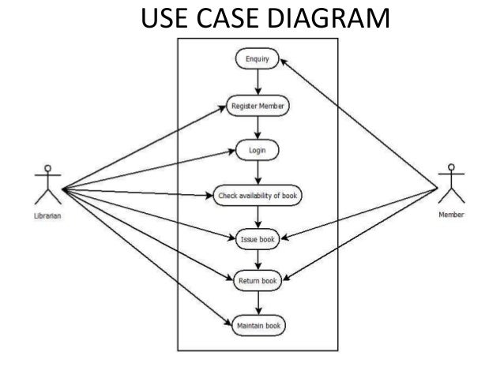
USE CASE

Slide 8
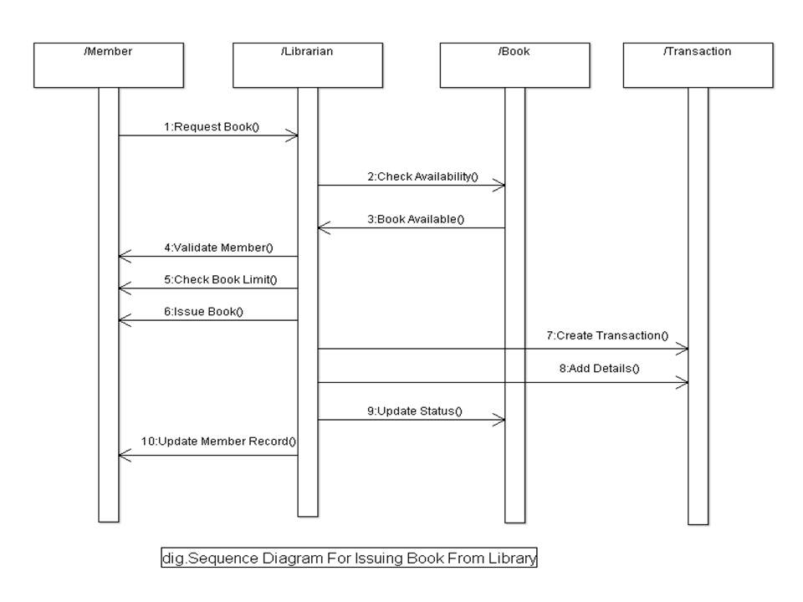
Sequence diagram

Slide 9
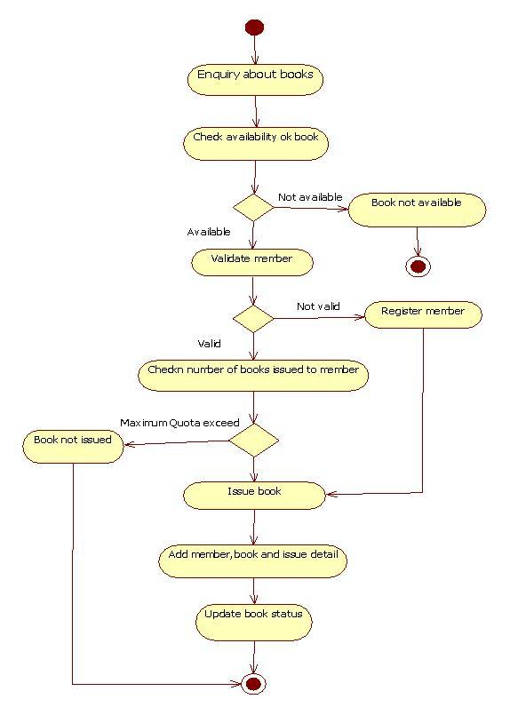
Activity diagram

Slide 10
conclusion
The library Management System allows the user to store the book details and the person’s details.
This software allows storing the details of all the data related to library.
The implementation of the system will reduce data entry time and provide readily calculated reports.

Slide 11
Thank you

